Slide 1
Corona Crimes
Exploring how the COVID-19 has affected crime to more efficiently distribute resources

Slide 2
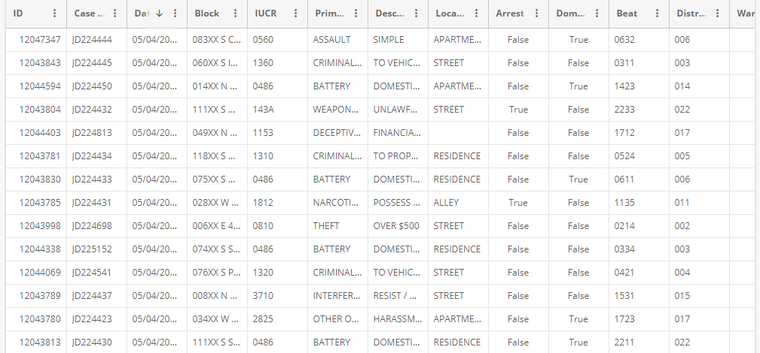
Data set
All crime in Chicago since 2001, excluding the last seven days (updated daily), downloaded 5/11/2020.
Link: https://data.cityofchicago.org/Public-Safety/Crimes-2001-to-present/ijzp-q8t2
Preview:

Slide 3
Lockdown
Chicago went into lockdown March 21
Fewer people outside -> Less crime?
(People stuck at home -> More domestic violence?)
Fewer people around -> Crime happens in new places?

Slide 4
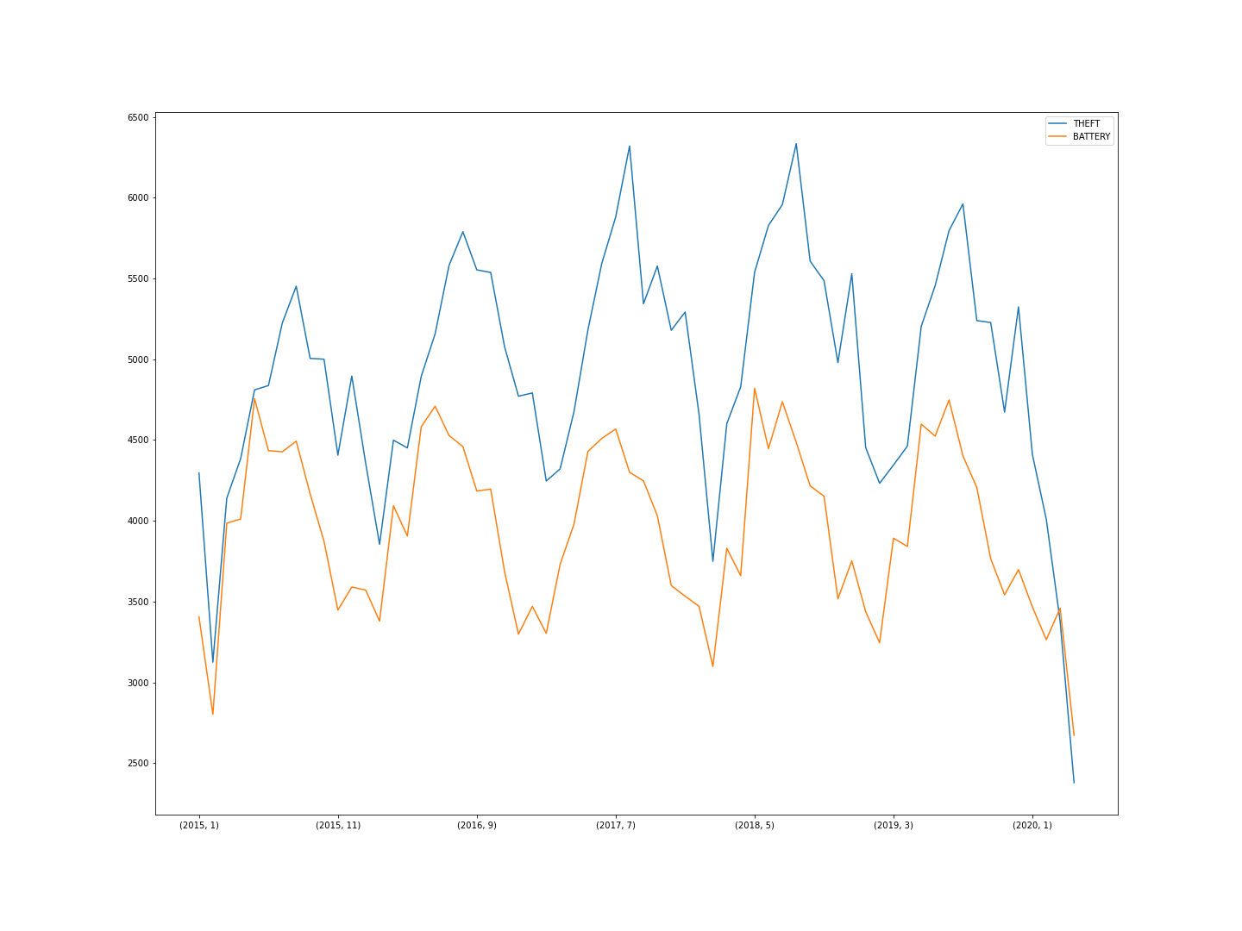
Trend

Slide 5
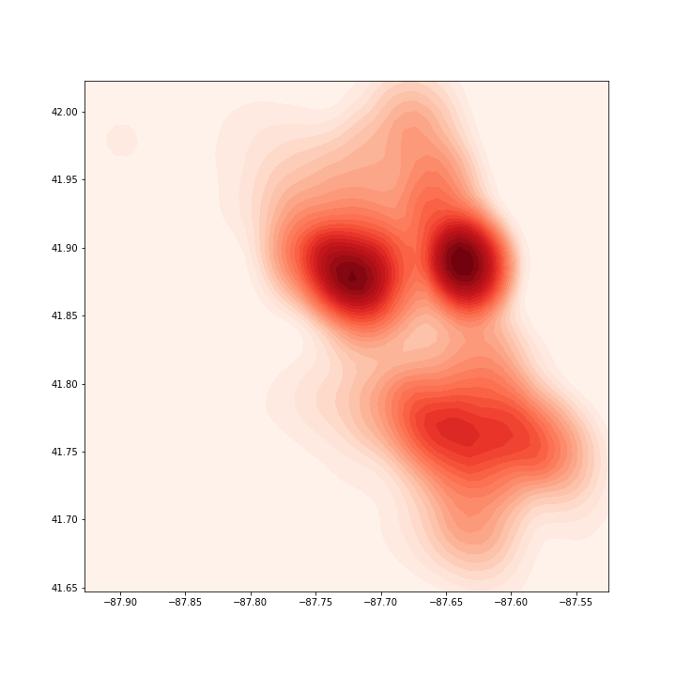
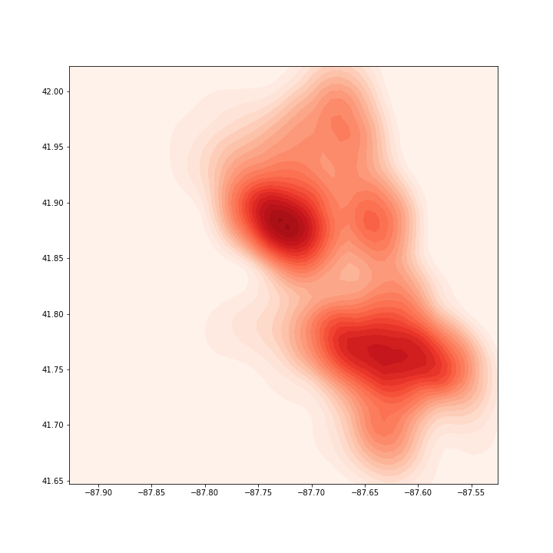
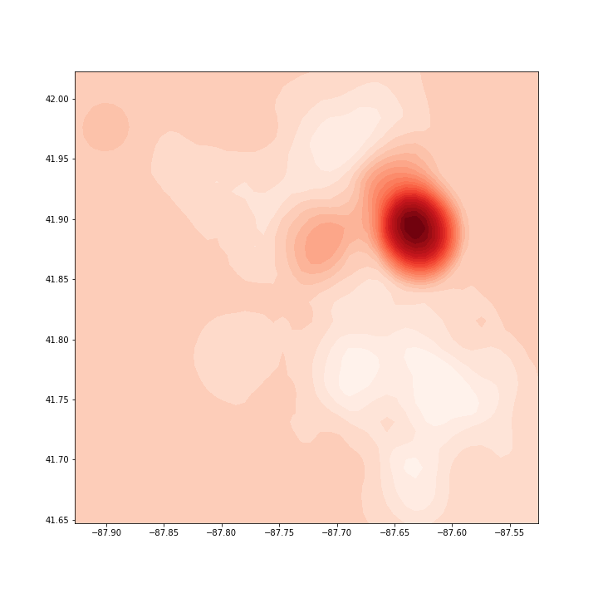
Locations
Kernel Density Estimate for the locations of crimes in April 2020.
Compared to KDE for older data (all since 2015, early 2020, April 2019):

